Slide 1
Case Study 2: Retail
ShopEverything
Names: Kiruthika Venkatachalam & James Kopal
BrainStation
Cybersecurity Course

Slide 2
CONTENTS
Executive Summary
Incident Analysis
Communication
Risk Mitigation & Business Analysis
Risk Register Template
Approach & Action Plan
Key Takeaways
Appendices & Assumptions

Slide 3
EXECUTIVE SUMMARY
Overview of ShopEverything: A large retail and ecommerce company with over 500 stores across the country
Summary of the Incident: Phishing attack compromised sensitive data and systems.
Impact: Weak cybersecurity led to backdoor installations and the risk of reputational damage.

Slide 4
INCIDENT ANALYSIS
SECURITY
COMPANY
Key Issues: Phishing, unencrypted data, excessive access, and lack of detection tools.
Impact on CIA Triad: Compromised confidentiality and integrity of data.
Need for Better Access Controls: Weak passwords and no multi-factor authentication (MFA).

Slide 5
INCIDENT ANALYSIS
Phishing Email: The email was sent to company’s Operations Leads to reset their work email password and it has a link leveraging as a legitimate company website.
Credential access: The Operation Lead used a very weak password and it made publicly available and make easy for the threat actor to access it.
The threat actors and the company’s Operation Lead are the people involved in this attack and the process they used is the email communication and password reset. The technology involved in this attacks are Emails, Password Management, Security tools and access control system.
There were several technology components of the information system are relevant:
Email System
Database Management System - Place where employee’s sensitive data is stored
Web Applications - The fraudulent site mimicked as legitimate company web page
Access Control Systems - The system grants varying levels of access to users based on the job role
IT Security Infrastructure - Protective measures in place, which appear to be minimal based on the case

Slide 6
INCIDENT ANALYSIS
There were few defense systems in place as ShopEverything had limited number of access to handle the customer’s sensitive data and it was evidenced that one of the few IT security individual who reported the issue.
However, the effectiveness of those defenses appears to be lacking given the breach. To enhance security and prevent incidents the company could have implemented several key measures like:
Multi-Factor Authentication (MFA), Strong password policies, Advanced Email Filtering technology (Gmail Spam Filter) Access Controls and Proper Employee Trainings.

Slide 7
COMMUNICATION
Breach Discovery: Detected accidentally by security staff, reported internally to IT.
Issues: Lack of transparency risks customer trust and reputational damage.
Recommendations: Implement public disclosure protocols and align with a Crisis Communication Plan.
Recommendation for Future Communication
The company should establish a clear escalation process for reporting and handling security incidents across departments.
They should issue a public statement acknowledging breaches to maintain transparency and customer trust. Communication protocols should be in the Incident Response Plan (IRP) for timely customer updates and notifications.

Slide 8
RISK MANAGEMENT & BUSINESS ANALYSIS
Identified Risks: Phishing, data breaches, weak passwords, and backdoors.
Business Impact: Regulatory non-compliance, financial loss, and reputation damage.
Recommendation: Continuous risk assessments and tighter vendor management.

Slide 9
RISK MANAGEMENT & BUSINESS ANALYSIS
Note: Some other companies are monitoring similar risks-
Cyber Risk - Cyber Risk is a top concern among North America businesses now, and is expected to remain to be high in the near future as ransomware attacks continue to grow.
Supply Chain and Vendor Risk - Companies (and consumers) continue to face persistent supply shortages, delays, and rising commodity costs.
Warehousing and Logistics Issues - The retail company could run out of stocks while orders are coming in, a product shipment might be delayed, or a parcel could be delivered to the wrong recipient.
Intellectual Property Issues - Companies website images, product descriptions, logos, videos, music, as well as their products, could be copied by others, or violate someone else’s intellectual property.

Slide 10
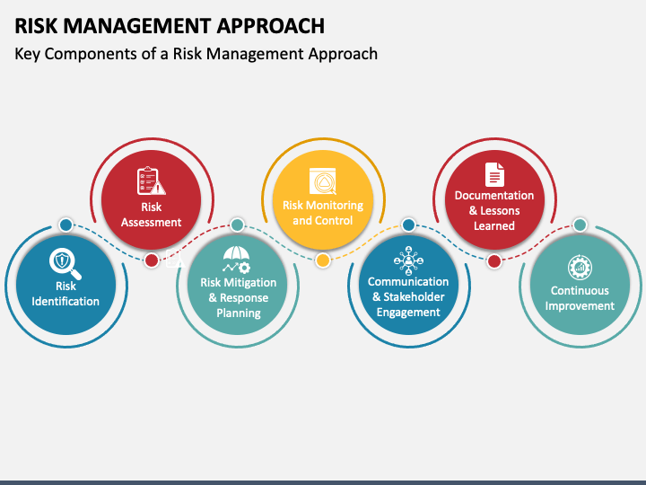

Slide 11
RISK MANAGEMENT APPROACHES
The following risk management approaches would enhance the system security of Shop Everything:
Encryption: Encrypting customer data would protect against unauthorized access.
Access Control: By granting appropriate level of access control to authorized personnel and denying access to unauthorized functions or individual.
Password policy: Enhancing strong password policies and regular password changes.
Incident Response Plan: Develop and test an incident response plan ensure to prevent or take alternate actions if another breach is happens.
Internal Audits: Conduct regular security assessments and penetration testing to identify vulnerabilities.
Training: Implement regular security awareness training to educate employees about phishing emails and strong password practices and conducting webinars about cyber security threats and alters could gain knowledge and we could mitigate the risk.
Transparency with Customers: If a breach occurs, be transparent about the situation to maintain customer trust.

Slide 12
APPROACH & ACTION PLAN
ShopEverything has limited cybersecurity maturity based on its weak practices: storing sensitive data in plain text, lack of encryption, weak password policies, and poor access controls.
To address the identified risks, the key actions are: implementing Data Encryption, strengthening Access Control, and Enhancing Phishing Protection.
The required resources include:
People: CISO, Employee Training Programs
Technical: SIEM and Intrusion Detection Systems, Encryption Tools, Multi-Factor Authentication (MFA)
Capabilities: Incident Response, Continuous Monitoring

Slide 13
RISK REGISTER
Mars
Jupiter
Saturn
Risk | Priority (Likelihood x Impact) | Risk Management Approach | Solution
Data Breach (unencrypted data storage) | High | Preventative measures | Encrypt all sensitive data in transit
Phishing Email Attack | High | Email filtering, employee training, anti-phishing tools | Conduct phishing awareness sessions
Weak Passwords (use of plaintext) | Medium | Increase password strength | Use Hash and better authentication (lockouts, CAPTCHA)
Malware/Ransomware Attack (lack of detection) | Medium | Antivirus, | Deploy endpoint detection and EDR tools

Slide 14
RISK REGISTER
Risk | Priority (Likelihood x Impact) | Risk Management Approach | Solution
Insider Threats | Medium | Implement tighter access controls, monitoring, and behavior analysis | Establish strict vendor management policies and limit data sharing
Third-Party Risks | High | Establish strict vendor management policies and limit data sharing | Minimize data sharing to only necessary information. Conduct regular security audits of vendors. Implement third-party contracts with clear data-handling guidelines

Slide 15
APPROACH & ACTION PLAN
In terms of NIST Framework, all of the elements could be improved (Identify, Protect, Detect, Respond, and Recover and is summarized below:
Identify: Improve risk management and asset classification.
Protect: Enhance data security through encryption, access control, and employee training.
Detect: Implement real-time monitoring systems like IDS and SIEM for better threat detection
Respond: Establish an incident response plan with clear communication protocols.
Recover: Develop a recovery plan and focus on continuous improvement post-incident with also a Disaster Recovery Plan and regularly backup all critical data.
After analyzing this, it's crucial to prioritize Protect (encryption, MFA, access control) and Detect (real-time monitoring) measures to prevent breaches and detect threats early.

Slide 16
INDUSTRY BEST PRACTICES & KEY IMPROVEMENTS
Data Encryption & Access Control: Implement encryption for customer data and enforce multi-factor authentication (MFA) and role-based access controls (RBAC) to secure sensitive systems.
Implement Real-Time Monitoring: Deploy SIEM (security information & event management) and network intrusion tools for continuous monitoring and early detection of suspicious activity.
Train Employees on Cybersecurity Awareness: Regularly train employees on phishing, password security, and data handling, and conduct phishing simulations.
Learning from Other Companies: Get inspiration from financial, healthcare, and tech companies like Google, Microsoft, and Amazon for best practices in proactive security and risk management (zero trust, regular training, access controls).

Slide 17
KEY TAKEAWAYS
Implementing Clear Security Policies and Response Plans
Recommendation: Establish a comprehensive incident response plan (IRP) and create clear data governance policies to manage customer data responsibly.
Strengthening Security Awareness
Employees are vulnerable to phishing and social engineering attacks due to lack of awareness.
Recommendation: Implement mandatory security awareness training for all employees, focusing on recognizing phishing attempts and handling sensitive data securely.
Upgrading Security Infrastructure
Critical gaps exist in data protection, access controls, and threat detection.
Recommendation: Encrypt all sensitive data, implement multi-factor authentication (MFA), role-based access control (RBAC), and deploy real-time monitoring tools like SIEM and IDS.
Proactive Approach to Future Threats
No proactive risk management practices in place to prevent future incidents.
Recommendation: Incorporate the identified threats into a Risk Register, prioritize them, and conduct regular risk assessments.

Slide 18
APPENDICES & ASSUMPTIONS
The security team is small and operates under a general IT department, indicating that security is not yet a top priority.
The company does not have a strong incident response process and decided not to disclose a significant breach, which may indicate a lack of a risk-aware culture.
Recommend that the company build a dedicated Cybersecurity team with a Chief Information Security Officer (CISO) to drive security strategy.
Company could benefit suggested improvements (more personnel, budget for security tools and training).

Slide 19
Thank you!

Slide 20
REFERENCES
Liu, H., & FTC, S. at the. (2022, October 6). Understanding the NIST cybersecurity framework. Federal Trade Commission. https://www.ftc.gov/business-guidance/small-businesses/cybersecurity/nist-framework#:~:text=NIST%20is%20the%20National%20Institute,The%20Framework%20is%20voluntary.

